Slide 1

Beacon (Hi tech Marine Loading and Path Detection
Binit Kumar
PT0981122

Slide 2
Scene
XYZ is the courier and Logistics company , available across whole Asia.
The CEO wants to reduce cost and time by reducing complexity in the system by Information Technology .
They require a new system that help them on the complex and tedious task and make a clear cut view of problem area.

Slide 3
Major Problems in Beacon
Travelling Salesman Problem ( route planning)
Algorithms for TSP
Container Loading Problem ( load planning)
Algorithms for CLP
Implementation using genetic programming
Graph generation and graph Editor

Slide 4
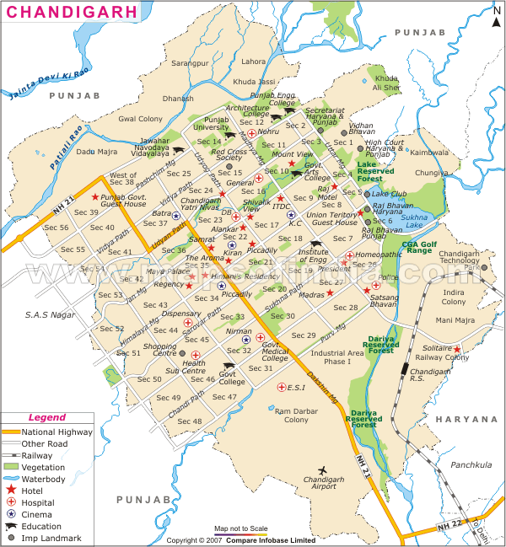
Travelling Salesman Problem

Slide 5
Complexities
Its NP-hard problem that is unsolvable in polynomial time
Its grows exponentially in every step ,so any supercomputer can’t also solve it
Very complex to produce a result for large number of destinations
Maximum scientists believes that there is not best single solution can be arrived

Slide 6
Container Loading Problem

Slide 7
complexities
Also unsolvable like TSP
More complex because of 3D structure
Constraints like ship balance , weight etc
Very complex to map into programming

Slide 8
Genetic Algorithm
Based on the Darwin’s theory of survival of fittest.
Non heuristic algorithms
It generated solutions to optimization problems using techniques inspired by natural evolution, such as inheritance, mutation, selection and crossover.
Genetic algorithms are one of the best ways to solve a problem for which little is known.
( P. Bajpai , M.Kumar 2008 , pp 1-3)

Slide 10
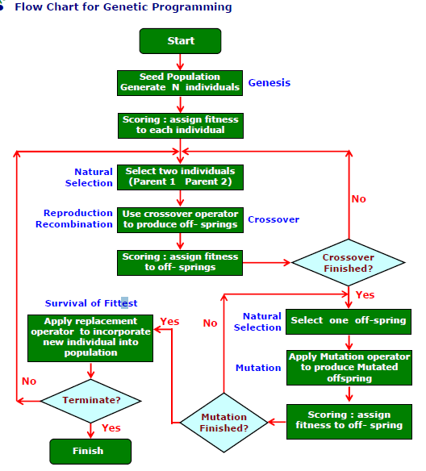

Slide 11
Secondary Research
Visual Basic 10 ( programming language )
Object Oriented Design
Protection and efficiency
Indexes
Exception Handling
Error Elimination
Graphical User Interface
Graphics Class
Stream Writer and Binary Writer

Slide 12
Modified Waterfall Model
Stable Project Requirement
Progress of System is measure able
Strict Sign off Requirements
Flexibility in V –model
Change in basic design is also possible

Slide 13
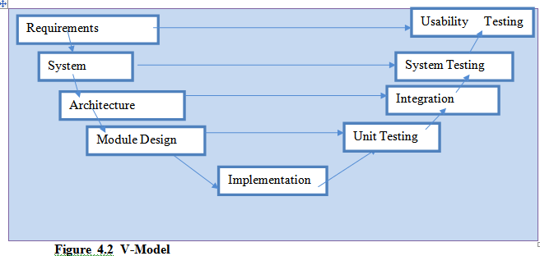

Slide 14
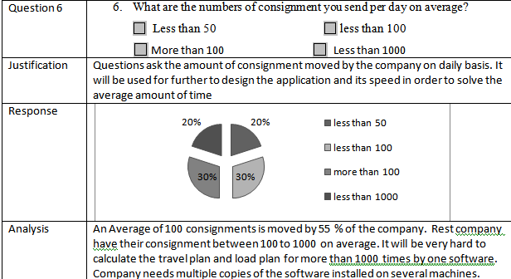
Analysis of Questionnaire

Slide 15
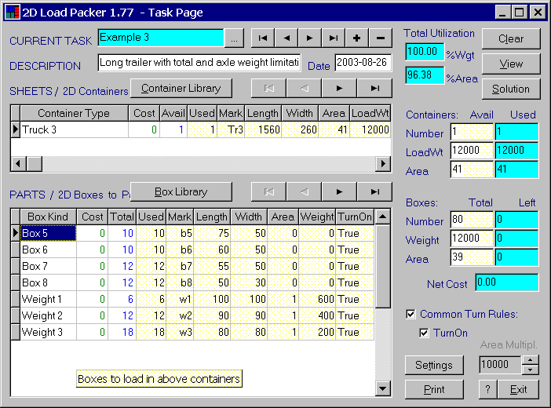
Review of Similar System
2D load Packer
PackVol
Google Map

Slide 16
Thank You
Questions ???

